Slide 1
^{Zonta, Gender Equity, and} ^{a Vision for 2030 & Beyond} Strategic Plan Goals and Strategies 2023–2030

Slide 2
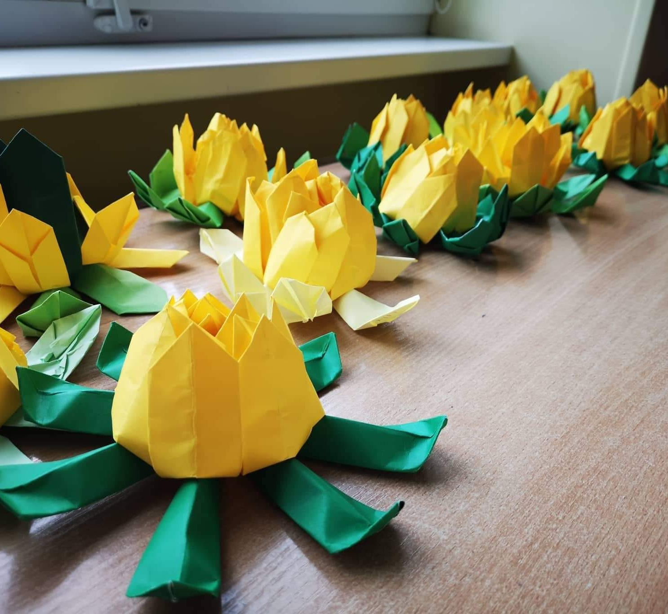
Develop a new strategic plan to meet the needs of Zontians while opening new pathways
for other gender equity advocates who care about our causes to engage with Zonta.
The plan will be developed in year one of the biennium and shared with all members.
THE OBJECTIVE

Slide 3
The Process: Developing a Refreshed Vision
Gender-based issues facing women and girls
Zonta International leaders recognize a need to prepare for the future.
Convention approved review of Zonta International under Resolution 2.
Evaluation of Zonta data, trends, assets and financial health.
Working groups reviewed internal operations and programs.
Member-based focus groups and surveys were conducted.
A PESTLE analysis was completed.
The Zonta International Board participated in a strategic planning retreat.
Position of Zonta International
Evolution of technology and societal structures
AREAS REVIEWED

Slide 4
Zonta must expand its credibility and visibility in the world on key advocacy issues.
For Zonta to be successful, there must be faith in the clubs and members must enjoy a healthy club life.
Zonta must seek out new members, allies and partners who are like-minded in the drive to build a better world for women and girls.
ON THE MINDS OF INTERNATIONAL LEADERSHIP

Slide 5
At the core, Zonta will not change and will remain a place where globally minded individuals connect, collaborate and demand change to build a better world for women and girls.
But we must remain relevant for the future and open to change to continue as a sustainable and strong community of individuals working together to fight for gender equity.
ON THE MINDS OF INTERNATIONAL LEADERSHIP

Slide 6
Update to Mission
Zonta International is a leading global organization of individuals working together to build a better world for women and girls.

Slide 7
2023-2030: Our Mission & goals
Mission: Zonta International is a leading global organization of individuals working together to build a better world for women and girls.
Goal 1: Credible and Visible Voice
Zonta acts as a credible and visible voice on gender equity and delivers initiatives addressing education equality, climate justice, ending gender-based violence, and ensuring women are represented in decision-making positions on an equal basis with men.
READINESS FOR THE FUTURE WILL REQUIRE…
Goal 2: Club Success
Clubs serve as a welcoming and inspiring environment to those who wish to work to empower women and girls and create information and resources necessary to focus on the most important issues facing women and girls.
Goal 3: International Leadership & Sustainability
Zonta manages its resources, including both time and money, to meet the vision and ensure the organization’s long-term viability and success. Zonta modernizes its governance structure to align with its strategic plan, ensure innovative thought and allow for effective decision-making.
Goal 4: Engagement of Audiences & Alliances
Zonta creates customized pathways to connect to Zonta, develops collaborations with like- minded organizations, and expands revenue streams to further our mission and extend our voice.

Slide 8
2023-2030: Our goals
1
Credible and Visible Voice
Zonta acts as a credible and visible voice on gender equity and delivers initiatives addressing education equality, climate justice, ending gender-based violence, and ensuring women are represented in decision-making positions on an equal basis with men.
1
Credible and Visible Voice
2
Club Success
3
International Leadership & Sustainability
4
Engagement of Audiences and Alliances

Slide 9
EQUITY
EQUALITY
Resources given based on needs
Everyone gets the same resources
Situation focuses on everything being fair,
in regards of current status
Situation focuses on everything being the same, regardless of current status
Outcome is equal
Outcome is not equal
www.zonta.org

Slide 10
GOAL & KEY STRATEGIES #1
Zonta acts as a credible and visible voice on gender equity and delivers initiatives addressing education equality, climate justice, ending gender-based violence, and ensuring women are represented in decision-making positions on an equal basis with men.
1.1 Provide a place for members to contribute their ideas to an on-going global conversation, and to increase their actions as gender equity advocates to drive the change women and girls need.
1.2 Develop and deliver programs and initiatives that provide cross-cultural community building and knowledge sharing on topics relevant to women’s rights and that make a difference in the lives of women and girls.
1.3 Expand international content and communication strategies to demonstrate authority
on issues facing women and girls in the world.

Slide 11
GOAL #1 Credible and Visible Voice
STRENGTHENING OUR EFFORTS
Zonta will build upon the long-term success of Zonta Says NO as the flagship campaign for our international, national and local activities for addressing gender-based violence.
Zonta will fully embrace climate justice as an area of focus, and we will further develop Zonta Says NOW as the flagship campaign for our activities to address climate justice at local, national and international levels.
Zonta International will affirm ending child marriage as its signature project and will encourage support and advocacy on the issue at all levels of the organization.
Zonta will demonstrate its commitment to educational equality through meaningful fellowships, scholarships and awards that address equality of access or equality of opportunity for women and girls.

Slide 12
GOAL #1 Credible and Visible Voice
EXPLORING NEW OPPORTUNITIES
While maintaining its focus on service, Zonta International will place a greater focus on advocacy and in doing so, increase Zonta’s credibility and visibility on issues facing women and girls in the world.
Zonta International will direct time and resources to integrated public relations and communications strategies to position Zonta as an authority on gender equality issues globally.

Slide 13
2023-2030: Our goals
2
Club Success
Clubs serve as a welcoming and inspiring environment to those who wish to work to empower women and girls and create information and resources necessary to focus on the most important issues facing women and girls.
1
Credible and Visible Voice
2
Club Success
3
International Leadership & Sustainability
4
Engagement of Audiences and Alliances

Slide 14
GOAL & KEY STRATEGIES #2
Club Success Clubs serve as a welcoming and inspiring environment to those who wish to work to empower women and girls and create information and resources necessary to focus on the most important issues facing women and girls.
2.1 Increase focus on the value of Zonta clubs to deliver impact in their local communities.
2.2 Expand focus and support for forming and chartering new Zonta clubs.
2.3 Recognize the right of clubs and individuals to have self-determination.
2.4 Encourage the Zonta Spirit for a healthy club life and inclusive environment.

Slide 15
GOAL #2 CLUB SUCCESS
STRENGTHENING OUR EFFORTS
Zonta International will expand the club creator program and tools to support the chartering of Zonta clubs in new and existing Zonta countries.
Zonta will continue to champion the Zonta Spirit as integral to creating healthy and vibrant Zonta clubs.

Slide 16
GOAL #2 CLUB SUCCESS
EXPLORING NEW OPPORTUNITIES
Zonta International will recognize and celebrate meaningful local projects addressing gender equity, education equality, climate justice, women in decision-making positions or gender-based violence.
Zonta will simplify club governance and give clubs greater autonomy and flexibility to operate in a way that best serves the club and club members.

Slide 17
2023-2030: Our goals
3
International Leadership & Success
Zonta manages its resources, including both time and money, to meet the vision and ensure the organization’s long-term viability and success. Zonta modernizes its governance structure to align with its strategic plan, ensure innovative thought and allow for effective decision-making.
1
Credible and Visible Voice
2
Club Success
3
International Leadership & Sustainability
4
Engagement of Audiences and Alliances

Slide 18
GOAL & KEY STRATEGIES #3
ZI Leadership & Sustainability Zonta manages its resources, including both time and money, to meet the vision and ensure the organization’s long-term viability and success. Zonta modernizes its governance structure to align with its strategic plan, ensure innovative thought and allow for effective decision-making.
3.1 Sustain current sources of revenue while evaluating operational and cost structures to be best positioned for the future.
3.2 Protect Zonta's assets with prudent management and a long-term view of organizational health.
3.3 Address Zonta International governance, leadership and internal structures to
enable the effective achievement of our mission.
3.4 Enhance trust in the Zonta Foundation for Women for its work with unique and impactful programs which will attract donations and raise new funds from diverse avenues.

Slide 19
GOAL #3 International Leadership & Success
STRENGTHENING OUR EFFORTS
Zonta International will continue to take steps to optimize operations and align resources with strategic priorities.
Zonta will seek new and improved ways to increase the number of talented individuals qualified and ready to hold club, district and international offices.

Slide 20
GOAL #3 International Leadership & Success
EXPLORING NEW OPPORTUNITIES
Zonta International will enhance Zonta’s value proposition and craft meaningful, personalized member experiences for club members, supporting members, young professionals and student club members, resulting in greater member and donor retention.
Zonta International will modernize its governance structure to ensure the organization and its leadership are agile and ready to meet the changing demands of the future.

Slide 21
2023-2030: Our goals
4
Engagement of Audiences and Alliances
Zonta creates customized pathways to connect to Zonta, develops collaborations with like-minded organizations, and expands revenue streams to further our mission and extend our voice.
1
2
Club Success
3
4
Engagement of Audiences and Alliances
Credible and Visible Voice
International Leadership & Sustainability

Slide 22
GOAL & KEY STRATEGIES #4
Engagement of Audiences & Alliances Zonta creates customized pathways to connect to Zonta, develops collaborations with like-minded organizations, and expands revenue streams to further our mission and extend our voice.
4.1 Leverage and market programs and engagement opportunities to introduce
Zonta to new audiences of gender equity advocates.
4.2 Broaden Zonta’s support base by attracting and welcoming new Zontians to our
clubs and wider membership.
4.3 Enhance existing collaborations with like-minded organizations to increase
information and resources for our members, while seeking opportunities to elevate
Zonta’s message with others.
4.4 Seek out new collaborations with like-minded organizations to expand alliances,
partnerships, and sponsorships.

Slide 23
GOAL #4 Engagement of Audiences and Alliances
STRENGTHENING OUR EFFORTS
Zonta International will elevate visibility and awareness of its work at the United Nations and Council of Europe while seeking out new partnerships to expand Zonta’s reach and influence.

Slide 24
GOAL #4 Engagement of Audiences and Alliances
EXPLORING NEW OPPORTUNITIES
Zonta International will investigate alternative strategies to engage new members and supporters through additional membership categories and other opportunities to contribute to Zonta’s mission.
Zonta International will seek out like-minded organizations, non-governmental organizations and corporations to partner with to broaden Zonta’s advocacy, fundraising and awareness-raising efforts.

Slide 25
The timeline
February
March
April
May
June
July
August
September
October
November
The Board meetings to finalize strategic plan.
Prepare the strategic plan for publication.
Publication of the strategic plan.
Informational presentations at the interdistrict meetings April to June 2023.
Member webinars on final strategic plan July – September 2023.
Zonta International Board representatives deliver presentations at district conferences.
Potential Zonta International Bylaws possible amendments investigated June – November 2023.

Slide 26
Zontians
Zontians
Zontians
Zontians
Clubs
Clubs
Districts
Districts
Clubs
Clubs
Zontians
Zontians
Zontians
Zontians

Slide 27
Q&A

Slide 28
Find more information and follow the process at www.zonta.org/StrategicPlan.
FOLLOW
ALONG

