Slide 1
ADVOCACY
Women’s Empowerment Principles
WEPs

Slide 2
Goal
The CEO of the company to sign the Statement of Support for the WEPs.
To date, more than 1300 CEOs representing a range of sectors have done it!

Slide 3
What Does It Mean?
By signing the Statement of Support, the CEO of the company commits to initiate, continue and report annually initiatives to achieve gender equality at the working place.
This is generally a difficult process that requires building up infrastructure in the company in forms of policies and procedures.

Slide 4
Is it Possible in a Company in my City?
Study the company’s
Website
Policies & procedures
All other governance documents
Have a conversation with the leader of the HR department
Answer the questions in the score card
If the answer to all the questions is NO, then it will be very difficult.
If the answer to at least 3 of the 7 questions is YES, then it might be worth trying.

Slide 5
Is it Possible in a Company in my City?
Run the free and anonymous online test at https://weps-gapanalysis.org/
The WEPs tool containing 18 questions followed by analysis and identification of areas of work for improvement.
Based on the results, it is possible to decide if the effort to be done is within the resources the Zonta club or Zontian has.

Slide 6
How to?
5
Take the steps, measure the achievements, report successes.
4
Agree with HR what steps can be taken.
3
Contact HR of the company and give a presentation (see https://www.zonta.org/Global-Impact/Advocacy/Womens-Empowerment-Principles)
2
Determine what can be done within reasonable time.
1
Take the WEPs test

Slide 7
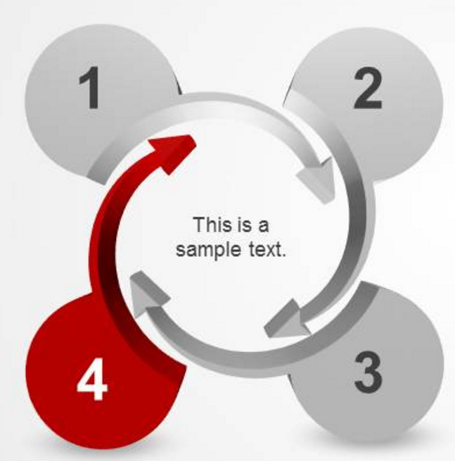
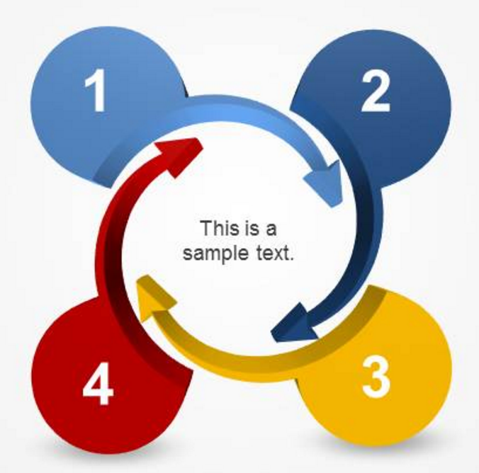
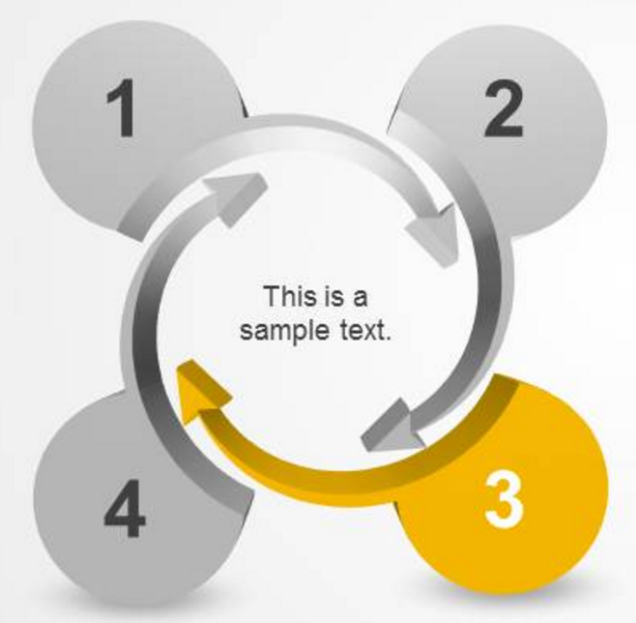
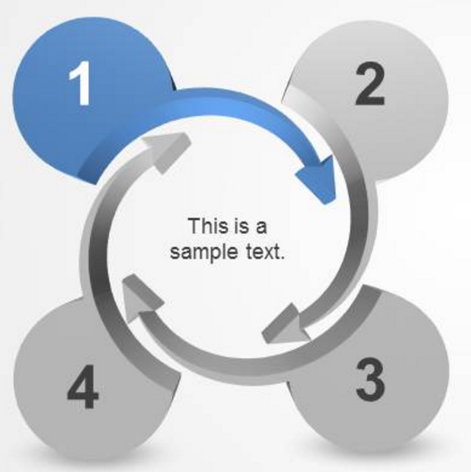
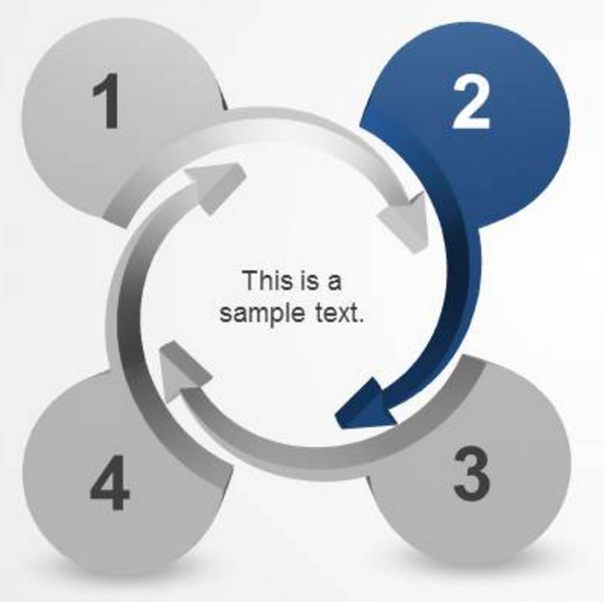
Women’s Empower Principles
COMMIT
ASSESS AND DEFINE
WEPs
IMPLEMENT AND MEASURE
COMMUNICATE

